Slide 1
Permit to Work System
TDI-Brooks International
December 2014

Slide 2
Basics
TDI-Brooks’s permit to work system is described in the SMM in SOP-GEN-012B
A permit to work system is a formal written system used to control POTENTIALLY HAZARDOUS WORK.

Slide 3
The 5 Why’s of a Permit
Why do we have to write permits?
Federal Law requires a written permit for potentially dangerous work.

Slide 4
The 5 Why’s of a Permit
Why did they make it a law?
Because while many people die on the job each year, these activities have the highest fatality rates.

Slide 5
The 5 Why’s of a Permit
Why did more people die doing this type of work?
Because the workers are exposed to greater hazards.

Slide 6
The 5 Why’s of a Permit
Why weren’t they more careful to work safely?
Because they didn’t recognize the hazards or were so used to them that they became complacent.

Slide 7
The 5 Why’s of a Permit
Why would they allow themselves to become complacent if it was so dangerous?
Fatigue, rushing to finish the job, frustration, didn’t think it was important, nothing bad had happened before.

Slide 8
Permits and Risk Assessment
The permit isn’t the point!
The point is to slow down,
recognize the risks and
have a plan to protect yourself and others.

Slide 9
Permitted Work
TDI-Brooks requires a permit for:
Hot Work
Working at Heights (over 6 ft off the deck)
Energy Isolation
Confined Space

Slide 10
Definitions
Hot Work- (29 CFR 1915)
“Any riveting, welding, burning, or other fire or spark producing operations”
If it produces a spark, it needs a permit

Slide 11
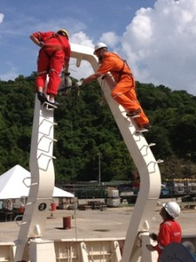
Definitions
Working at Heights (SMM)
Any work 6 feet or more above the deck
Fall protection must be worn unless a risk assessment determines that it would create a greater hazard.

Slide 12
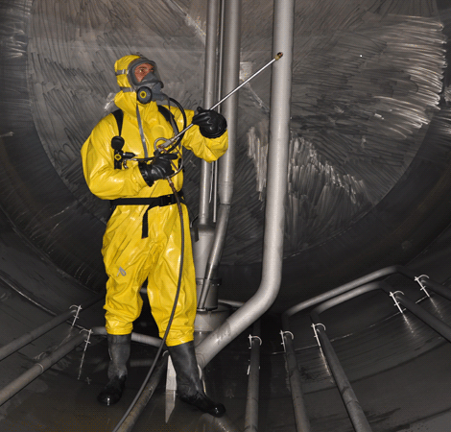
Definitions
Confined Space
Any entrance into a registered permit-required confined space on the vessel
Confined Spaces on all vessels are listed in the SMM.

Slide 13
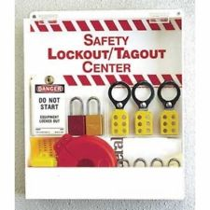
Definitions
Energy Isolation (Lockout/ Tagout )
29 CFR 1915
Required to prevent activation of equipment or release of stored energy that could harm a person

Slide 14
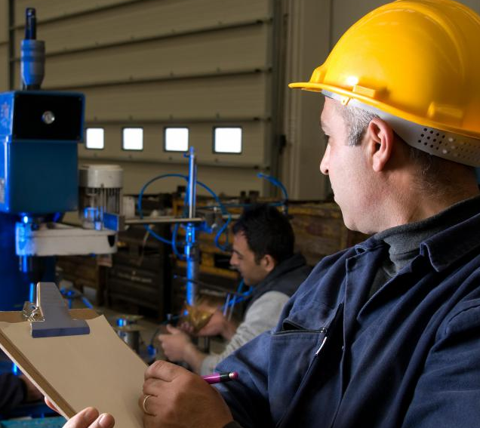
Definitions
Authorized Person (SMM)
The person empowered by TDI to approve and sign a permit

Slide 15
Definitions
Authorized Persons: (SMM)
Working at Heights- Master or Mate
Energy Isolation or Hot Work- Chief Engineer

Slide 16
Definitions
Authorized Persons: (SMM)
Confined Space- Must be signed by BOTH Master and Chief Engineer

Slide 17
Definitions
Alternate Authorized Persons
The Port Engineer may authorize any permit when a Master, Mate or Chief Engineer is not available

Slide 18
Risk Assessment
Before performing a task, you need to assess the risks.
A Job Safety Analysis (JSA) is integrated into each permit and should include a rescue plan for the worker if needed.

Slide 19
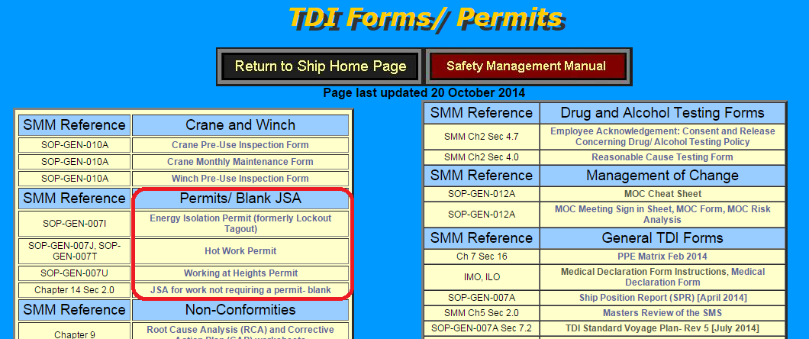
Where to find permits
Permits are located on the ship web pages on the TDI Forms/ Permits page.

Slide 20
In Doubt? Print it out!
The first two pages of the Permit contain a flowchart and detailed instructions on how to complete the permit, who is authorized to sign it and how to enter it in the NS5 work order.

Slide 21
Flowchart- Page 1 of the Permit
The flowchart shows the process for documenting ALL work – planned, unplanned, with or without a permit.

Slide 22
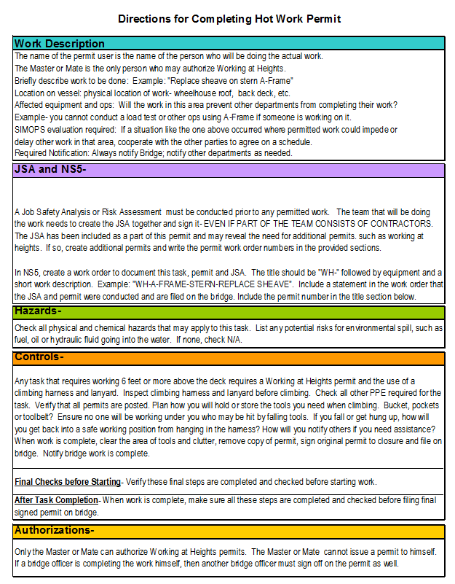
Instructions Page 2 of Permit
The second page states who the Authorized Person is and how to enter the WO into NS5.

Slide 23
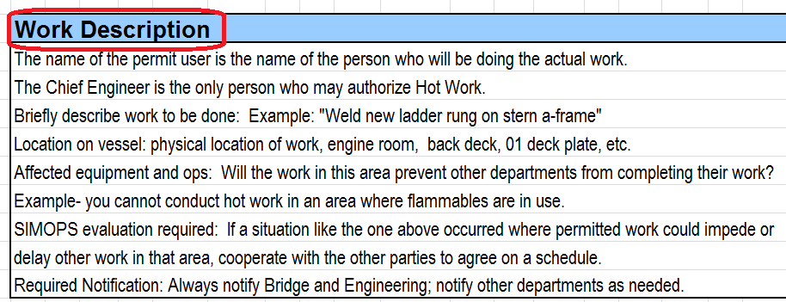
Read Instructions!!
The instructions will tell you exactly what to enter in each section:

Slide 24
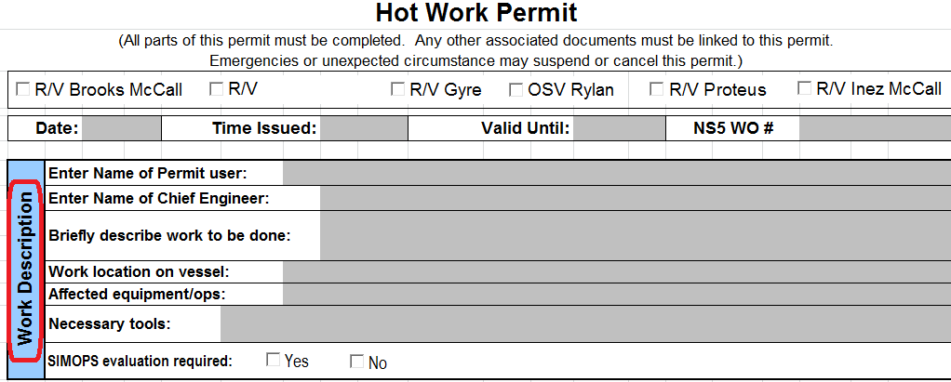
Work Description Page 3 of Permit
Fill out ALL info

Slide 25
Special Permits & PPE
More than one permit may be needed.
Shift change is documented in this section
PPE is documented next

Slide 26
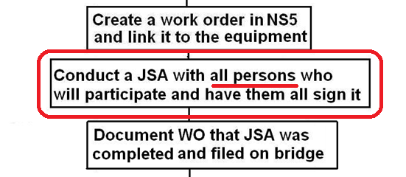
JSA (from flowchart)
Everyone participates in the JSA– INCLUDING CONTRACTORS

Slide 27
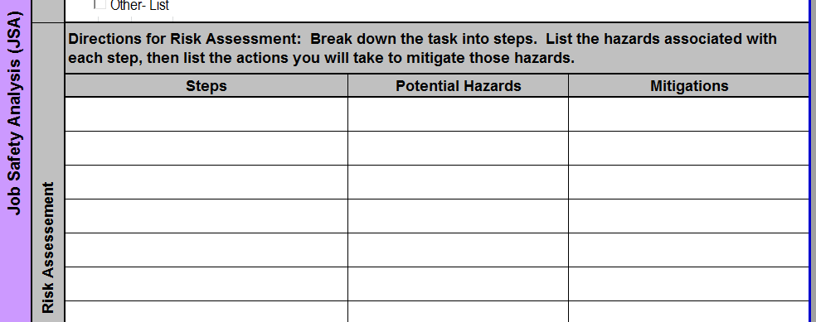
JSA Risk Assessment
Risk Analysis is included in the Permit as a JSA. Include a rescue plan in JSA for Working at Heights and Confined Space
What could go wrong? Plan for it here.

Slide 28
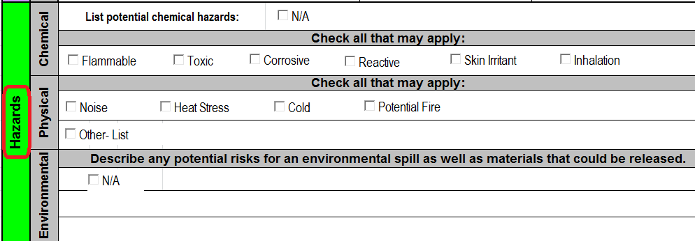
Hazards
The section below the JSA will include an list of potential hazards and controls to mitigate them. Weather and sea state would be included here.

Slide 29
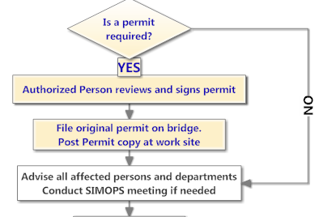
AFTER the JSA–
Authorized Person Signs
Post Copy at work site/ Original on Bridge
SIMOPS meeting if needed

Slide 30
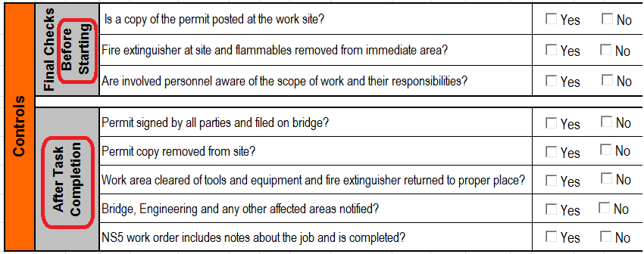
Controls
Controls apply both before work begins AND after work has been completed.

Slide 31
Controls
Based on the pre-start controls, which type of permit is this?
After completing all the previous steps and final checks before starting, you may BEGIN WORK.

Slide 32
12 Hour Rule
Working at Heights and Hot Work permits are only good for 12 hrs. If work will continue after the 12 hrs, a new permit must be issued.
** The only exception to the 12 hr rule is Energy Isolation. It may take weeks to get a part in. A single EI permit will suffice until the repair can be made.

Slide 33
Change of Shift
If permitted work crosses into the change of shift, the new workers must complete a new permit, but can review the JSA from the previous permit.
So– New shift workers = new permit
But- can use the previous shift’s JSA - as long as it is reviewed with all new workers

Slide 34
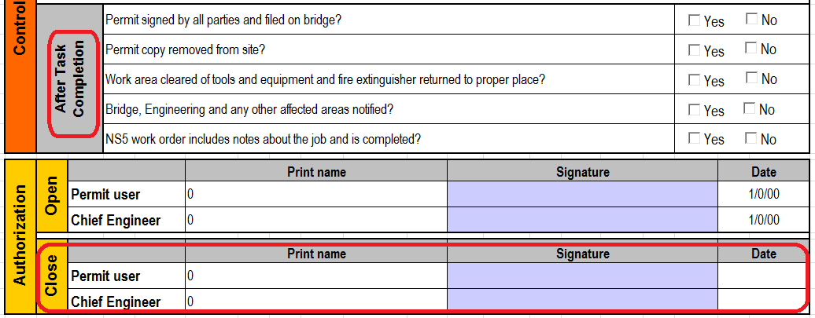
When work is complete… the paperwork continues
When work is finished, you must complete the After Task Controls and the Authorized Person must sign that the job is complete.

Slide 35
Finally!
The after task completion is to ensure :
When all of these steps are completed, you are done! Make sure the correct copy is filed on the bridge–( the one with all the final checks and signatures)

